Slide 1
OOP CONCEPTS IN PROGRAMMING

Slide 2

Think In Objects, Not Just Code
Everything around you can be imagined as an "Object."
Example: A User (you), a Restaurant, a Menu Item.
In coding, each object will become a "Class" (like a blueprint).

Slide 3
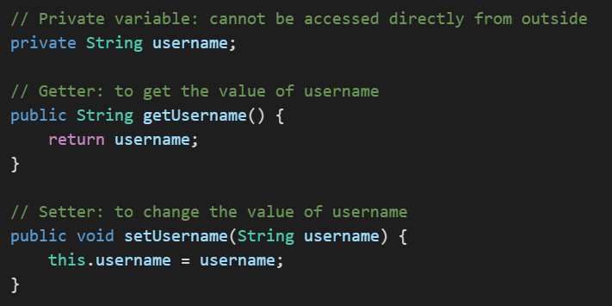
Encapsulation (Keep Data Safe)
Encapsulation means "hiding" important data.
We use private to keep variables safe inside a class.
To get or change data, we use special small methods called getters and setters.

Slide 4
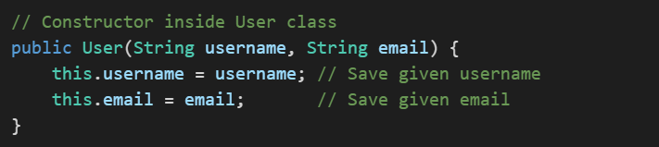
A constructor is a special method used when we want to create an object. It gives the object its starting values.
Use Constructors to Build Objects

Slide 5
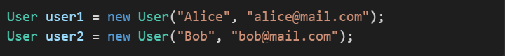
Quote
One Class, Many Objects
One class can create many different "real" objects.

Slide 6
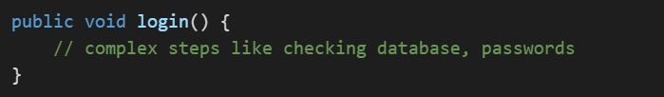
Abstraction (Hide Complexity)
Abstraction means hiding the complicated parts from users.

Slide 7
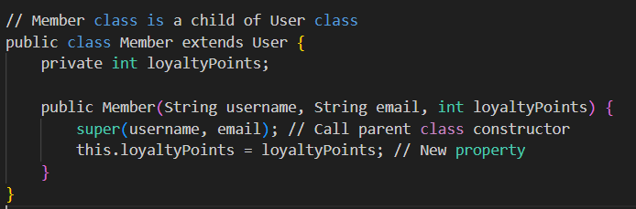
Quote
Inheritance (Reuse Code)
Inheritance means a new class "borrows" properties from an old class.
.

Slide 8
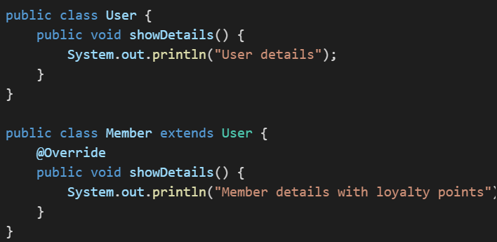
Quote
Polymorphism (One Name, Many Behaviors)
Polymorphism means methods with the same name can do different things.
.

Slide 9

Project Overview
What Will Happen?
Open app → See New User button.
Fill registration form → Create user object.
Validate data → Save user to database.
Show success or error message.
We are building:
A Home Page (UI)
A Registration Form (UI)
A User Class (Model)
A Database Handler (Controller)
Validation checks.

Slide 10
Quote
Why Are We Using OOP in This Project?
Organize User details clearly.
Make future changes (like adding categories) easy.
Secure user data using private attributes.
Connect the app to a database properly..
Real Example - Our User Class
Our User object will have:
Username
Telephone
Date of Birth
Email
Password
Category

Slide 11
Constructor - Building the Object
When you click "Create" in the form:
Constructor will build a new User object.
All entered information will go inside the object.
Getters and Setters - Protecting the Data
Getters → allow us to read user data.
Setters → allow us to update user data carefully.

